Slide 1




FINITE AUTOMATA PLAYGROUND
TEAM - 20
BL.EN.U4AIE20031 - KUNISETTY JASWANTH
BL.EN.U4AIE20051 - PRANAV RAMACHANDRULA
BL.EN.U4AIE20055 - S SRUTHI

Slide 2
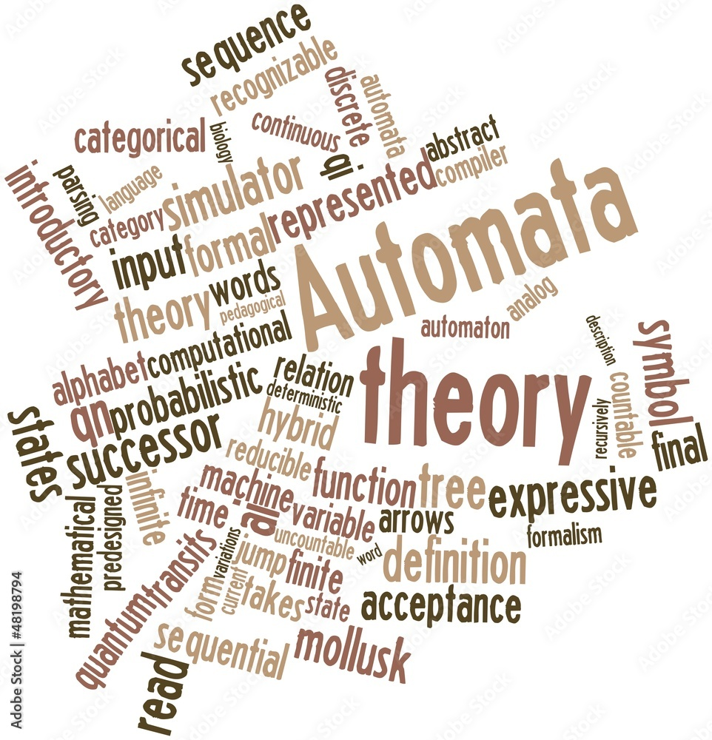
Contents
01
Problem Statement
02
Implementation using jflap
03
GUI using pyform language
04
Results

Slide 3

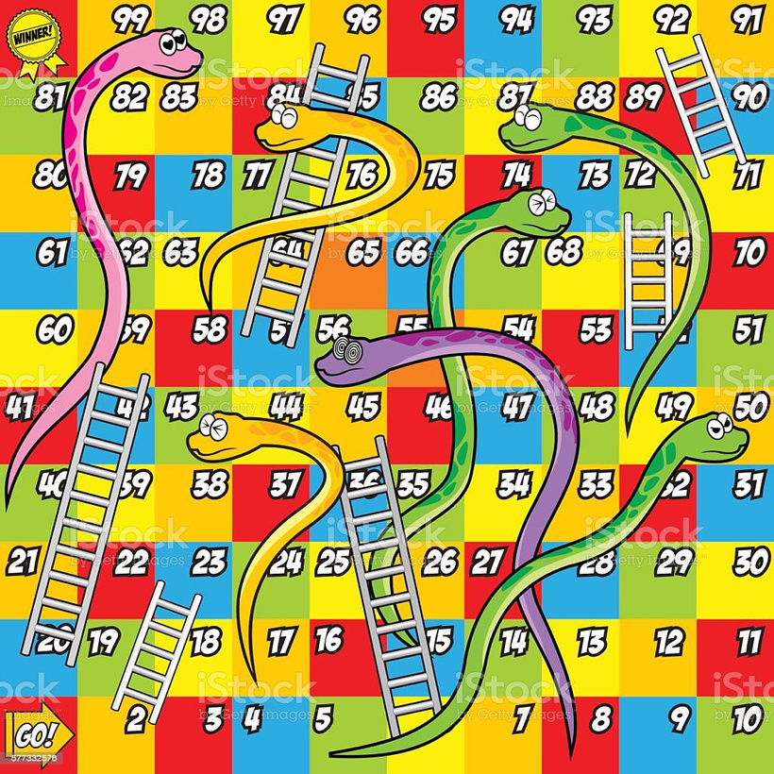
PROBLEM STATEMENT
Using jflap:
Creating a model for snake and ladders using jflap which defines the person who reaches 100 states with minimum transitions as winner

Slide 4

PROBLEM STATEMENT(CONTD.)
Using pyformlang:
Developing a UI tool using streamlit
to visualize the different automata namely Deterministic Finite Automata , Non-Deterministic Finite Automata and Regular Expression

Slide 5
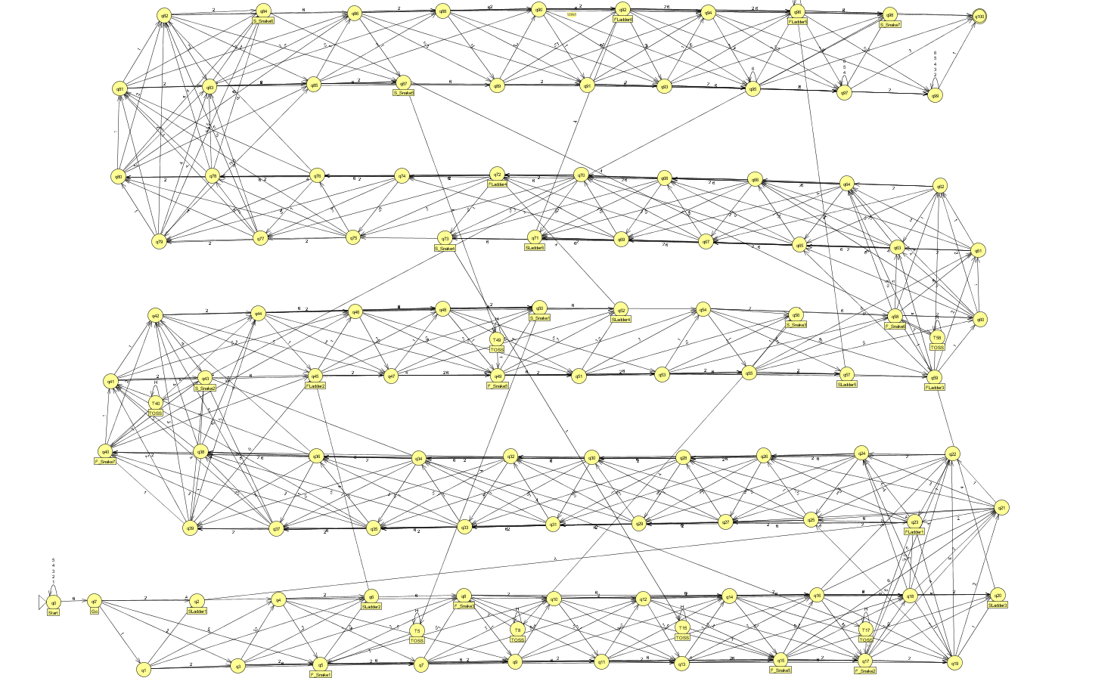

Implementation using jflap
Snake and Ladders
Model using jflap

Slide 6
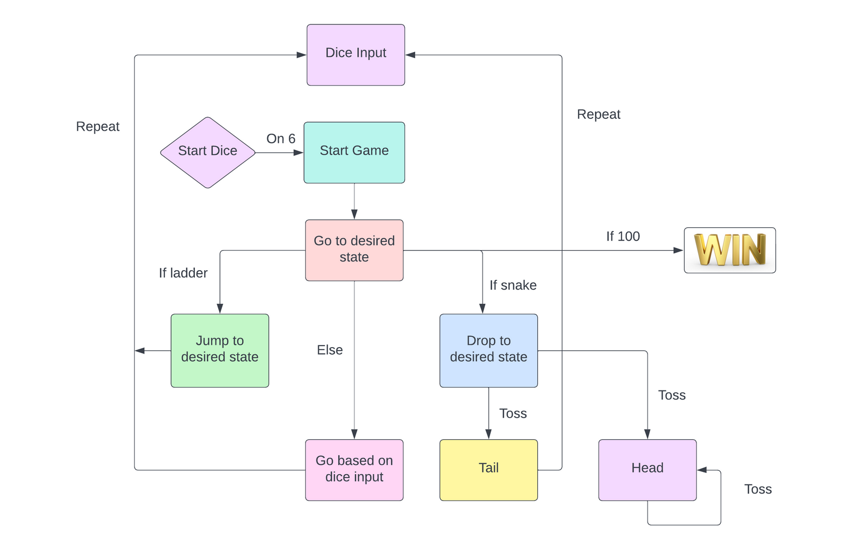
Flowchart for the game :

Slide 7


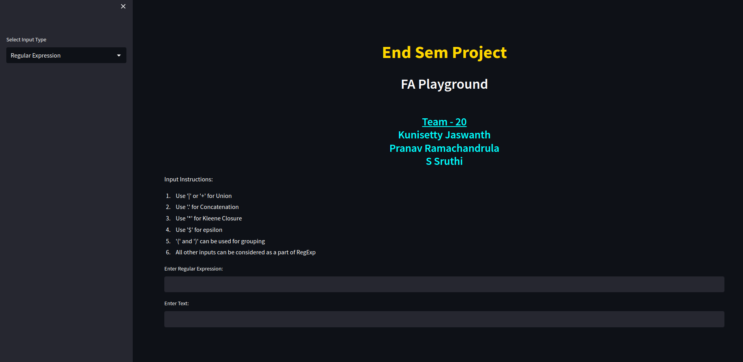
GUI for FA Playground

Slide 8
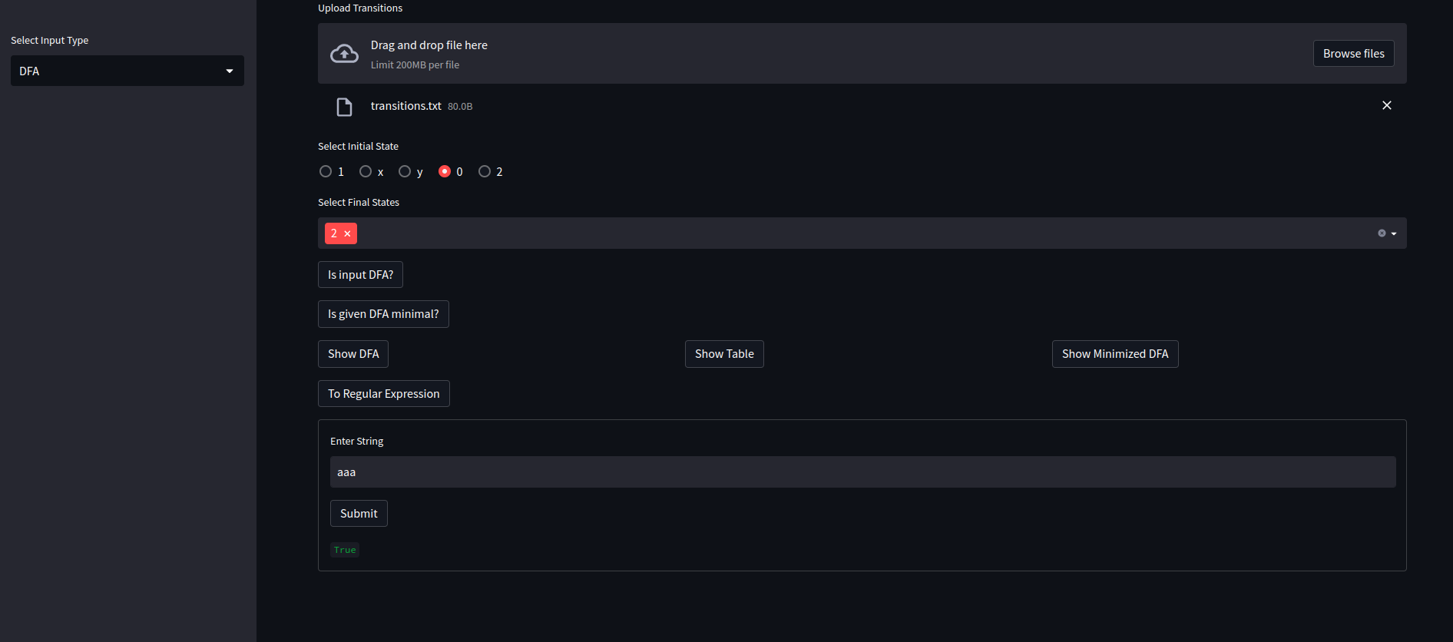
GUI for FA Playground

Slide 9
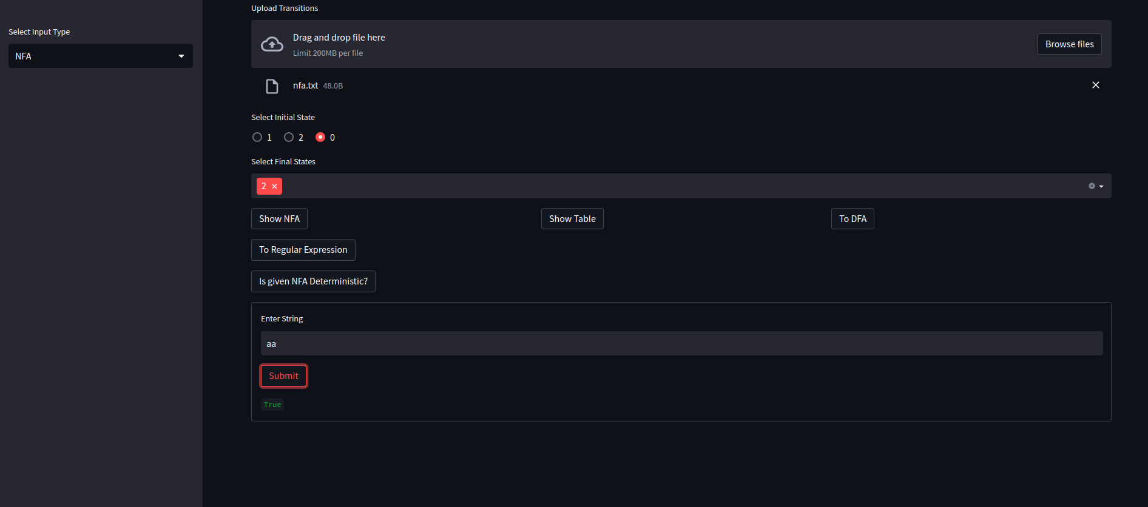
GUI for FA Playground

Slide 10
THANK YOU

